Slide 1


Slide 2
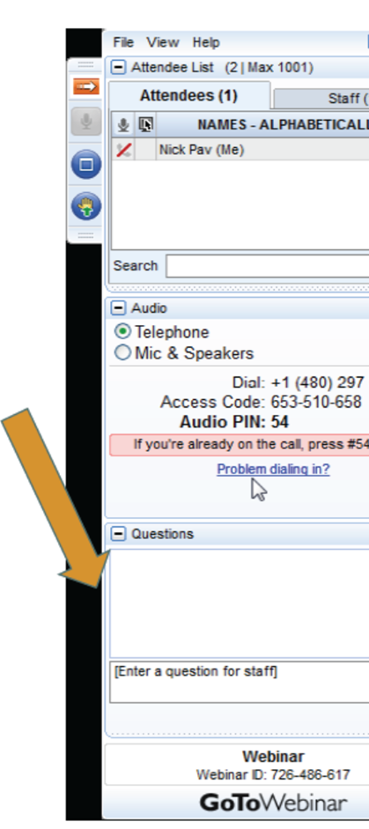
LOGISTICS
Webinar resources, including recording and supplemental materials, will be posted at https://allianceforchildrensrights.org/resources/
All attendees are muted during webinar.
Please submit questions using the “Questions” function on your GoToWebinar dashboard.
Notes:
Kristin/Sara
A few quick logistics: This webinar is being recorded, and resources including the slide deck and supplemental materials will be posted on our website at allianceforchildrensrights.org/resources. All attendees are muted, but we encourage you to submit questions using the ‘Questions’ function on your GoToWebinar dashboard. We’ll address as many as we can during the Q&A.
We’re pleased to welcome Marisa Lopez-Scott, a Directing Attorney at the Youth Law Center, this morning. Her work focuses on providing advocacy support for civil legal aid attorneys across California with an emphasis on transforming the lives of youth impacted by the dependency system. Before joining Youth Law Center, Marisa was a dependency attorney at Legal Advocates for Children and Youth (a component of the Law Foundation of Silicon Valley) representing children ages 0-21 in their child welfare proceedings. Prior to LACY, she was a staff attorney at Bay Area Legal Aid’s Youth Justice Project, representing youth impacted by the juvenile justice and child welfare systems and youth experiencing homelessness through the provision of comprehensive civil legal services.

Slide 3

New Program Requirements for THP-NMD
Disclaimer: This presentation by the Youth Law is provided for educational and/or informational purposes only, and should not be construed as legal advice.

Slide 4

Youth Law Center
The Youth Law Center (YLC) is a non-profit legal advocacy organization that has worked for four decades to transform foster care and juvenile justice systems across the nation so every child and youth can thrive.
Notes:
YLC is a nonprofit legal advocacy organization that has worked for four decades to transform foster care and juvenile justice systems across the nation so every child and youth can thrive. YLC’s advocacy aims to ensure children and youth are not only protected from harm and dangerous conditions in systems but also receive the support, opportunities, and love they need to grow up healthy and happy.

Slide 5
Support Center Function and Services
Youth Law Center is a Qualified Support Center that provides free legal training, legal technical assistance, and advocacy support to the legal community across California.
Trainings and Workshops, Workgroups, and Outreach (trainings on substantive areas of expertise and best practices, participation in local and statewide workgroups, and quarterly outreach and mailing regarding new resources)
Consultation, Research, Co-Counseling and Technical Assistance (direct-assistance to advocates in our areas of substantive expertise, including advocate support for proposed legislation, pleadings and amicus briefs, and individual and systemic issues)
Resource Materials, Information Services and Support (create trainings, toolkits, advocacy guides, facts sheets, policy bulletins and other resources, including co-authoring resources and trainings with other legal service providers)

Slide 6
Goals of Today’s Presentation
Provide a refresher on extended foster care and placement options for NMDs
Discuss THP-NMD Basics
Overview of licensing structure and rules for THP-NMD
Review Nonminor Dependent Rights
Highlight select provisions of the new regulations
      Intake Procedures
      Personal Rights
      Removal/Discharge
      Phone/Internet Services
Overview of Community Care Licensing (CCL) and the CCL complaint process
Resources
Questions

Slide 7
Overview of Extended Foster Care and Nonminor Dependent Placement Options

Slide 8
Overview of Extended Foster Care (EFC)(AB 12)
What is it?
  Provides an optional extension of foster care up until age 21
  Includes housing, case management, and ongoing services to transition to independence
  Youth in EFC are called “nonminor dependents” (NMDs)
Who is eligible?
  Youth must have turned 18 years old while subject to a foster care placement order through the juvenile dependency or delinquency court
  Youth must continue to be under the placement and care authority of the county placing agency and live in a licensed or approved setting
  Youth must have a transitional independent living case plan (TILCP) which documents the youth’s willingness to satisfy one of the five participation conditions under WIC 11403(b)

Slide 9
Optional Participation and Reentry
Extended foster care is optional – but is opt out
If a nonminor dependent (NMD) does not want to participate, they can request a hearing to terminate the juvenile court’s jurisdiction
When NMDs exit care, the juvenile court maintains general jurisdiction over them until age 21 to allow them the option to reenter (if they change their minds)
Youth can re-enter care an unlimited number of times until they turn 21
Reentry is intended to be accessible and easy
An NMD is entitled to benefits and placement again as of the date the Voluntary Reentry Agreement is signed

Slide 10
Benefits of EFC
Participation in EFC has been shown to improve outcomes for TAY (see generally the CalYOUTH study)
EFC includes:
    Case management and monthly visits provided by the county placing agency (child welfare or juvenile probation).
    Case planning, including the creation of a Transitional Independent Living Plan (TILP) to help the NMD work towards school, employment, and independent living goals and transition planning.
    Independent Living Program (ILP) services
    Safe and appropriate placement in the least restrictive, most family-like setting that meets the NMD’s needs
    A monthly foster care payment for the young person’s placement, plus any specialized rates such as the Infant Supplement or Expectant Parent Payment for parenting or expecting youth.
    Child and Family Team support and decision making
    Full-scope Medi-Cal

Slide 11
Placement Options in Extended Foster Care
Same as placements for minors (e.g. foster/resource parent)
Three additional placements are available specific to NMDs called Supervised Independent Living Settings (SILS) (WIC 11400(x))
      Transitional Housing Placement Program for Non-minor Dependents (THP-NMD)
      Supervised Independent Living Placement (SILP)
      Transitional Living Setting (TLS)
NMDs placed or residing out-of-state can still receive benefits (foster care benefits, right to a safe and appropriate placement, case management, and health insurance)

Slide 12
THP-NMD – What is it?
The Transitional Housing Placement Program for Nonminor Dependents (THP-NMD) is a transitional housing program that provides BOTH housing and supportive services to nonminor dependent foster youth
THP-NMD agencies are licensed as Children’s Residential Facilities by the Community Care Licensing Division (CCLD) of the California Department of Social Services (CDSS)

Slide 13
Who is Eligible for THP-NMD?
 | THP-M (Transitional Housing Placement Program for Minors) | THP-NMD (Transitional Housing Placement Program for Nonminor Dependents) | THP-Plus (Transitional Housing Program-Plus)
Age | 16 up to age 18 | 18 up to age 21 | 18 up to age 25
Duration of Program | No maximum duration if age requirements met | No maximum duration if age requirements met | 36 months
Status of Foster Care Case | Must have an order for foster care placement under the jurisdiction of the juvenile court as a dependent or ward, including minors under transition jurisdiction. | Must be under the jurisdiction of the juvenile court as a NMD or ward, including NMDs under transition jurisdiction, or be under the placement and care authority of a county welfare or probation department pursuant to a voluntary reentry agreement. | Must have exited from the foster care system, including foster care placement through probation, on or after 18th birthday.

Slide 14
Rights of Nonminor Dependents

Slide 15
Rights of NMDs
The Foster Youth Bill of Rights applies to all minors and nonminors in foster care, including those supervised by juvenile probation. (WIC § 16001.9)
If a nonminor dependent believes that their rights have been violated, the nonminor may contact or make a complaint with the Office of the Foster Care Ombudsperson, ask their court-appointed dependency attorney or juvenile defender to intervene or address the issue with the juvenile court, or file a community care licensing complaint.
Additionally, California law states that nonminor dependents, though under the jurisdiction of the juvenile court, are adults and have all the rights that a person who has attained 18 years of age may have as an adult under California law. (WIC § 303(d)(1))

Slide 16
Rights of NMDs (Continued)
The county placing agency is responsible for identifying and securing a safe and appropriate placement for the nonminor dependent (including THP-NMD) and assessing the county placing agency’s own capacity to provide safe and appropriate placements for all nonminor dependents in the county. (WIC § 16001(a), All-County Letter (ACL) 19-105, and ACL 21-95)
Nonminor dependents must be included in the selection and identification of a placement and in any placement decisions. (ACL 19-105 and ACL 11-77)
Finally, AB 12 tasked CDSS with creating program and placement regulations that “shall recognize the status of nonminor dependents as legal adults” and at a minimum, provide “that nonminors shall have the greatest amount of freedom that will safely prepare them for self-sufficiency.” (HSC § 1502.7(b))

Slide 17
State Licensing Rules for THP-NMD

Slide 18
State Licensing Rules for THP-NMD
THP-NMD agencies are licensed as children’s residential facilities by the Community Care Licensing Division (CCLD) of the California Department of Social Services (CDSS).
To become a licensed transitional housing placement provider, a provider must first obtain a certification from the applicable county specifying whether the facility will serve foster youth 16 to 18 years old, nonminor dependents, or both.
For purposes of certification, “applicable county” means the county where the administrative office or subadministrative office of a transitional housing placement provider is located or a primary placing county. (WIC 16522.1(e))
After receiving the county certification, the CCLD of CDSS can then license transitional housing placement providers using licensing standards in the Health and Safety Code (HSC) and California Code of Regulations (CCR).

Slide 19
Rules Governing THP-NMD*
Welfare and Institutions Code Section 16522.1,
Health and Safety Code Section 1559.110,
The Transitional Housing Placement Program Regulations (CCR Title 22, Division 6, Chapter 7),
The Transitional Housing Placement Program for Nonminor Dependents Regulations (CCR Title 22, Division 6, Chapter 7, Subchapter 2), and
The Manual of Policy and Procedures Sections 30-901—30-911.
* This is not an exhaustive list.

Slide 20
Further Guidance on THP-NMD
All-County Information Notice (ACIN) Number I-30-25,
ACIN I-40-11,
All-County Letter (ACL) 21-95,
ACL 11-69,
ACL 11-77
ACL 12-44, and
Provider Information Notice (PIN) 25-06-CRP (Children’s Residential Program).

Slide 21
How are the New Regulations Structured?
The new and amended regulations mark the first time that Division 6, Chapter 7 of the Title 22 Regulations applies to nonminor dependents who are legal adults.
The base chapter of the new and amended regulations, Division 6, Chapter 7, now applies to both the Transitional Housing Placement Program for Minors (THP-M) and THP-NMD, unless a regulation states otherwise.
Subchapter 1 only applies to THP-M and Subchapter 2 only applies to THP-NMD.

Slide 22
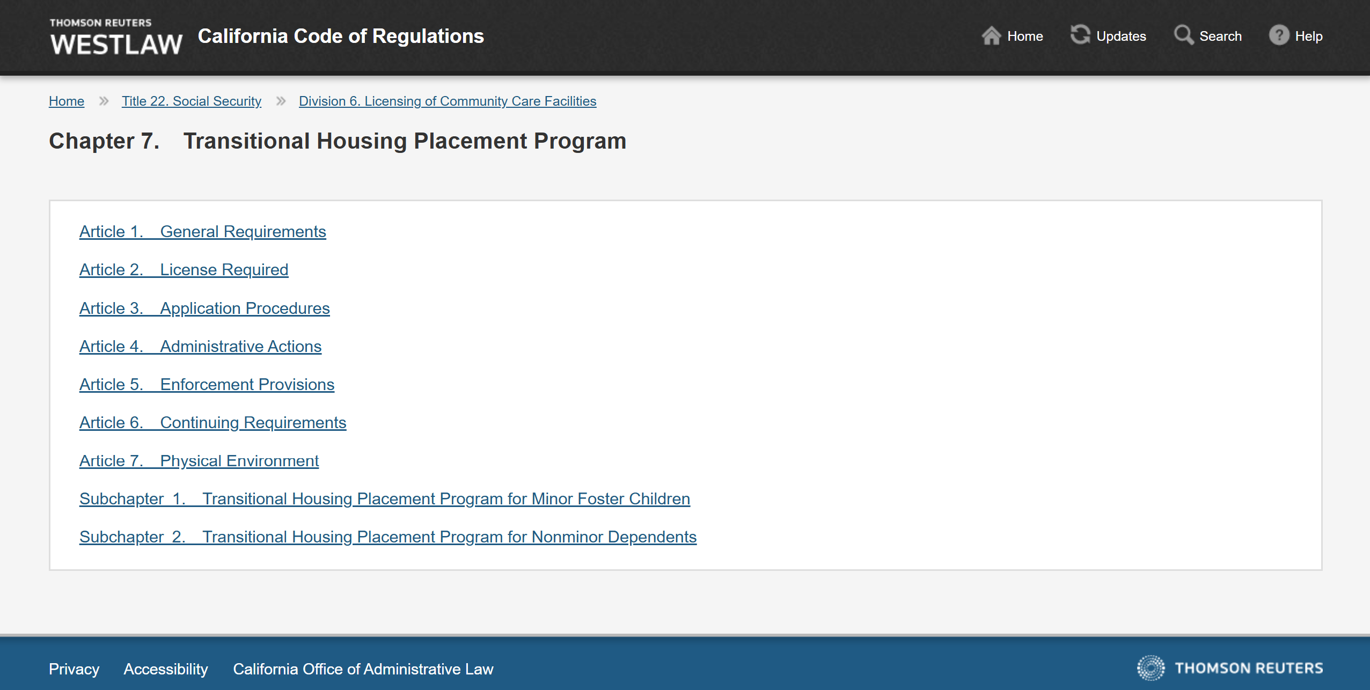
Apply to both THP-M and THP-NMD (unless indicated otherwise)
Only THP-M
Only THP-NMD

Slide 23
New Regulations of Note

Slide 24
Regulations Advocates Should be Aware of in Their Work with NMDs
  Intake Procedures
  Participant Rights
  Removal/Discharge
  Phone/Internet Services

Slide 25
Intake Procedures
The intake procedures for THP-NMD found at 22 CCR Section 86268.1 now require licensees to make efforts to engage the nonminor dependent during the Pre-Placement Appraisal and throughout the intake process.
  “Pre-Placement Appraisal” means “the holistic assessment of the NMD's needs and strengths and the licensee's capacity to meet those needs, as further described in Section 86268.1.” 22 CCR § 86001(p)(3).
The licensee shall determine whether it can meet the needs of the NMD consistent with the terms of the approved program statement, plan of operation, and county contract.

Slide 26
Intake Procedures (Continued)
If the licensee determines that it is “unable to meet the needs of a nonminor dependent due to an NMD’s mental, medical or physical disability” during the Pre-Placement Appraisal, “the NMD, on their own or through their designee, may request a reasonable accommodation or reasonable modification that would allow the NMD to participate in the program” and the licensee must engage in the legally required interactive process (22 CCR § 86268.1(b)(4)(A))
  The licensee is not obligated to grant a request for reasonable accommodation or reasonable modification if granting the request would impose an undue financial and administrative burdens on the licensee's operations or fundamentally alter the nature of the licensee's program, as determined by the licensee.
During the Pre-Placement Appraisal the licensee shall not have access to information and records contained in the NMD’s juvenile case file, juvenile police record, or sealed juvenile record, pursuant to Welfare and Institutions Code sections 362.5, 781, 786, 786.5, 827, and 827.9.
Notes:
In making these determinations, the licensee shall examine internal and community resources, including but not limited to, consideration of the following:
a. The licensee's own internal financial and administrative resources; and
b. In consultation with the county placing agency, what county and/or community resources are available to meet the nonminor dependent's needs.

Slide 27
Intake Procedures (Continued)
If the licensee determines it is unable to meet the needs of the NMD, “the written Pre-Placement Appraisal shall specify which of the NMD’s needs the licensee is unable to meet and the specific reasons why. 22 CCR § 86268.1(b)(4)(A)
The licensees must provide NMD with a copy of the Pre-Placement Appraisal, including all documents used or provided during the appraisal, and “with explicit consent from the NMD, the placing agency and the nonminor dependent's attorney.” 22 CCR § 86268.1(b)(5)
As part of the Pre-Placement Appraisal, the licensee shall not require a NMD to meet participation requirements that exceed the existing participation conditions for extended foster care as defined in WIC Section 11403(b). 22 CCR § 86268.1(e)
Finally, the licensee shall not discriminate against the NMD based on actual or perceived race, sex, gender identity and expression, sexual orientation, ethnic group identification, HIV status, ancestry, national origin, color, religion, mental or physical disability, medical condition, genetic information, citizenship, immigration status, primary language, or marital status. 22 CCR § 86268.1(d)

Slide 28
Personal Rights
The Foster Youth Bill of Rights (FYBOR) applies to all minors and nonminors in foster care, including those supervised by juvenile probation. (WIC § 16001.9)
If a nonminor dependent believes that their rights have been violated, the nonminor may contact or make a complaint with the Office of the Foster Care Ombudsperson, ask their court-appointed dependency attorney or juvenile defender to intervene or address the issue with the juvenile court, or file a community care licensing complaint.
The FYBOR has been incorporated into the THP-NMD regulations. Because these rights are incorporated into the regulations, violations of the FYBOR by licensed children’s residential facilities are also licensing violations.
The personal rights for THP-NMD found at 22 CCR Sections 86072 (applies to both THP-M and THP-NMD) and 86272 (just applies to THP-NMD).

Slide 29
Personal Rights (Continued)
Each participant, and their authorized representative, shall be personally advised with an age or developmentally appropriate orientation explaining the rights of the participant and addressing the participant's questions and concerns, and given a copy of the rights specified in Section 86072(b) at the following times:
      Upon placement in a THPP;
      At the request of a participant; and
      Each time a new right has been added to 22 CCR Section 86072(b) or Welfare and Institutions Code section 16001.9.
Under 22 CCR Section 86072(b)(12)(A), participants are entitled to receive an age-appropriate allowance in accordance with WIC 16522.1(b)(7)
  “An allowance to be provided to each participant in the program. In the case of a participant living independently, this allowance shall be sufficient for the participant to purchase food and other necessities.”

Slide 30
Personal Rights (Continued)
Section 86072(b)(14): participants have a right to have a placement that utilizes trauma-informed and evidence-based de-escalation and intervention techniques.
    Law enforcement intervention shall only be requested when there is an imminent threat to the life or safety of a participant or another person or as a last resort after other diversion and de-escalation techniques have been utilized and only upon approval of a staff supervisor.
    Law enforcement intervention shall not be used as a threat or in retaliation against the participant.
Section 86072(b)(18): participants have a right to participate in extracurricular, cultural, racial, ethnic, personal enrichment, and social activities, including, but not limited to, access to computer technology and the internet, consistent with the participant's age, maturity, developmental level, sexual orientation, and gender identity and gender expression.
Section 86072(b)(26): participants have the right to attend Independent Living Program classes and activities and to not be prevented by caregivers from attending as a consequence or punishment.
Section 86072(d): A licensee shall not subject a participant to harassment, punishment, or retribution for exercising the personal rights specified in Section 86072(b) and WIC section 16001.9.

Slide 31
Personal Rights (Continued)
In addition to the rights in Section 86072 and the FYBOR, NMDs have a few additional rights, included in Section 86272
Section 86272(a)(1): NMDs have the right to acquire and be allowed to possess, maintain, and use, adequate personal items, including furniture, equipment, and supplies for the participant's personal living space in accordance with their interests, needs, and tastes, including items that were given as gifts to the participant.
Section 86272(a)(7): NMDs have the right to have private or personal information including any medical condition or treatment, psychiatric diagnosis or treatment, history of abuse, educational records and information relating to their biological family maintained in confidence unless given express written consent by the participant.

Slide 32
Removal/Discharge
The removal procedures for THP-NMD, found at 22 CCR Section 86268.4, now require licensees to make attempts to preserve the placement before discharging a nonminor dependent from the program.
These requirements include:
      The creation of a written stabilization plan,
      Utilization of trauma-informed practices informed by the placement preservation strategies in Welfare and Institutions Code Section 16010.7, and
      Inclusion of the child and family team.
Additionally, the NMD should sign the removal or discharge policies as a part of the intake process and when they sign the admission agreement, and should be maintained in their record with a signed copy given to the NMD (Sections 86068(c)(5), (f); 86268.1(g)(2), (h)(3); 86268.4(a)(1)-(2)) 86270(b)(22)).
Notes:
This 14-day timeline is consistent with both Cal. Welf. & Inst. Code § 16522.1(d) and the Placement Preservation Strategies in Cal. Welf. & Inst. Code § 16010.7. The ILS contained only a 7-day notice requirement.

Slide 33
Removal/Discharge
Additionally, the permanent regulations:
    Incorporate the 14-day notice requirements (A 14-day notice is the written notice that a licensee must submit to the participant, the county placing agency, and the participant’s attorney to initiate the removal of a participant from the program.)
    Limit the circumstances under which an “emergency circumstances” removal can be initiated by the county placing agency,
    Require written notice to NMD’s attorney within 24 hours of an emergency circumstances removal, and
    Explicitly permit licensees to use their discretion to determine whether it is safe and appropriate to readmit NMD into the program once emergency circumstances no longer exist or if circumstances change.
    Add a 60-day written notice requirement for NMDs reaching the age of 21, to indicate that they will be discharged from the program at 21 due to reaching the age cap.
Notes:
This 14-day timeline is consistent with both Cal. Welf. & Inst. Code § 16522.1(d) and the Placement Preservation Strategies in Cal. Welf. & Inst. Code § 16010.7. The ILS contained only a 7-day notice requirement.

Slide 34
Limits on Emergency Circumstances Removals
The new regulations provide more clarity and limits on when an NMD can be removed from a THPP under “emergency circumstances”
A participant may be removed without prior notice from the THPP by the person or agency responsible for placing the participant, such as a social worker or probation officer, or other authorized person or agency under emergency circumstances.
Emergency circumstances include, but are not limited to:
      When the participant inflicts physical injury on, poses a threat of physical injury to, or poses a continuing threat to the mental health or safety of, another person(s) on the premises.
      When there is an imminent threat to the physical health and safety of the participant caused by their continued presence in the program.
      All emergency circumstances not expressly enumerated herein must be occurrences involving imminent danger to any person, or demanding immediate action to prevent or mitigate loss of, or damage to, life or health, or catastrophic damage to property.
Notes:
First note that it’s “may be removed” not must meaning it’s permissive, not mandatory. Additionally, the new regulations delete the previous categories of
(A) Removal by law enforcement officers when a nonminor dependent is arrested.
(C) Removal for emergency medical or psychiatric care.
Finally, they make more specific health and safety removals (previously: “(B) Removal becomes necessary when the health and safety of the nonminor dependent or others in the THPP is endangered by the continued presence of the nonminor dependent in the THPP.”)

Slide 35
Removal/Discharge (Continued)
The licensee may discharge a participant from the program with 14 calendar days prior written notice if the licensee determines that it is no longer able to meet the needs of the participant. Prior to making this determination, the licensee shall update the participant's Needs and Services Plan to include a 30-day stabilization plan to meet the needs of the participant and continue the current placement.
    The licensee shall make itself available to collaborate with the child and family team or, if the child and family team cannot be convened, a multidisciplinary team, in developing the stabilization plan.
    The licensee shall promptly notify the placing agency, the participant, and the participant's attorney if any in writing of the 30-day stabilization plan.

Slide 36
Removal/Discharge Timeline*
Participant at Risk of Removal/Discharge
Triggers Update to Needs and Services Plan to include 30-day written stabilization plan.
21 calendar days after delivery of stabilization plan notice
The licensee shall assess the participant's progress towards meeting the goals of the plan and complying with the signed removal or discharge policies and procedures.
(A) If the participant has come into compliance, the licensee shall issue a written notice to the participant stating that the participant may continue to remain in the program.
(B) If the participant has made progress towards coming into compliance, the licensee may, at its discretion, initiate a second 30-day notice.
30 days after the stabilization plan notice
If the participant has made insufficient progress towards coming into compliance with the signed removal or discharge policies and procedures, the licensee may provide a 14-day written notice.
44 days after stabilization plan notice
Participant may be discharged from the program at the end of the 14-day notice period if the licensee issued a 14-day written notice.
*Note: this timeline does not incorporate emergency circumstances removals or the 60-day written notice requirement from NMDs approaching age 21.
Notes:
when a participant is at risk of discharge because the licensee can no longer meet the needs of the participant or when the participant is in violation of the removal or discharge policies and procedures as further specified in subsections (e) and (f), respectively
(3) A 14-day written discharge notice may not be issued until at least 30 calendar days after the stabilization plan has been implemented and all parties have signed. If the participant declines to participate in the development of the stabilization plan, the implementation date is when the participant and placing agency are given a written copy of the stabilization plan.

Slide 37
Removal/Discharge
If the licensee issues a 14-day written notice for the participant to be discharged from the program, the notice must be provided to the participant, the placing agency, the licensing agency, and the participant's attorney, and the notice must:
    Contain the specific reasons for the discharge of the participant, with specific facts about any circumstance(s) or event(s) that resulted in the pending discharge, and
    Include a copy of the 30-day stabilization plan and a written description of the reasoning behind the licensee's determination that it can no longer meet the participant's needs.
The regulations include the ability for the county placing agency to continue to approve placement for up to 14 calendar days in a participant’s absence, if the participant provides notice to the licensee that they intend to return within 14 calendar days.
Finally, upon removal or discharge of a participant, a licensee shall surrender cash resources, personal property, and valuables of the participant, with the itemized inventory list, to the participant or to the placement agency in accordance with Section 86226.

Slide 38
Phone/Internet Services
The telephone, computer, and internet service regulations for THP-NMD found at 22 CCR Section 86273.
The regulations now require that the licensee ensure that in addition to their administrative/staff offices and units, participant living units must have landline, cellular or internet telephone service and internet service on the premises at all times.
Notes:
Though the regulations do not indicate that the licensee must be the payer, there's an argument that ensuring that internet services are on the premises at all times means the licensee must pay for them since provision of internet services can't be dependent on an NMD's own ability to pay. However, I imagine THPs insisting that payment of internet bills is part of increased responsibilities for young people to prepare them for exit from care.
Additionally, the "on the premises" phrase could imply that the internet just has to be available (for purchase), and that it does not require internet access to be paid for by a THP program. However, that could mean NMDs have to use and pay for the specifically-available internet service provider/package on site. If the NMD has to pay on their own for access to that specific network (of unclear cost and quality), that does not seem like an appropriate conclusion. And if NMDs would have to pay for their own network to avoid that outcome, then that seems like it could defeat or significantly weaken the purpose of requiring THP sites to guarantee internet services on the premises.
Finally, a provider might try to argue that they (the provider) are paying for the internet services by giving the NMD a stipend to pay for it, it is clear that the provider remains liable to use the youth's foster care payment to meet their basic needs (see Title 22, Division 6, Chapter 7, Section 86278(a) and WIC Section 11460(b)), so if having a youth pay for internet means that the young person doesn't have enough funding to pay for food or other basic needs, the THP provider should still be on the hook to provide additional funding.

Slide 39
Other Sections of Note
Applicable to all THP Programs
Applicable to THP-NMD
§ 86001 Definitions.
§ 86022 Plan of Operation.
§ 86030.5 Identification of Transitional Housing Placement Program Participant Living Units.
§ 86067 Reasonable and Prudent Parent Standard.
§ 86068 Admission Agreements.
§ 86072.1 Expectations, Alternatives, and Consequences.
§ 86072.2 Complaint and Grievance Procedures.
§ 86078.1 Core Services and Supports.
§ 86226 Safeguards for Cash Resources, Personal Property, and Valuables.
§ 86268.3 Needs and Services and Transitional Independent Living Plan (TILP).
§ 86270 Participant Records.
§ 86278 Responsibility for Providing Care and Supervision.
§ 86287 Buildings and Grounds.

Slide 40
Community Care Licensing Complaints

Slide 41
Community Care Licensing (CCL) Complaints Overview
What is a CCL complaint?
  A CCL complaint is a complaint that alleges that a facility, facility licensee, or facility staff person is out of compliance with licensing standards.
Who can make a complaint?
  Anyone can file a licensing complaint with CCLD if a licensed children’s residential facility has violated the state laws and regulations that govern it
How can someone make a complaint?
  To make a complaint, contact the appropriate Children’s Residential Regional Office based on the county where the foster care placement is located. If the youth or their advocate cannot reach the regional office, they may file the complaint online or call CCLD’s complaint hotline at (844) 538-8766.
  The complainant may also want to copy the State and/or a County Foster Care Ombudsperson’s Office when they make a CCL complaint because these ombudspersons have separate investigatory authority and/or ability to help reach an appropriate resolution for the youth.

Slide 42
What Happens After a Complaint is Made?
After a CCL complaint has been made, the Licensing Program Analyst (“LPA”) will contact the complainant (if contact information is provided) to notify them that an interview will be conducted and the LPA will conduct a facility site inspection within 10 days of receipt of the complaint. (HSC§ 1538(c); Community Care Licensing Division (CCLD) Evaluator Manual, 3-2011)
By law, unannounced inspections are conducted for all complaints. (HSC §§ 1533(b)(1), 1534(a), 1538, CCLD Evaluator Manual, 3-2011)
Site inspections of serious allegations will occur “within two business days, or as soon as practically possible.” (CCLD Evaluator Manual, 3-2011)
During the investigation, the LPA will undertake a site inspection, interview relevant persons, and review facility records to evaluate the circumstances of the alleged violation. (CCLD Evaluator Manual, 3-2301)
Licensing personnel may also review the young person’s juvenile case records under Welf. & Inst. Code Section 827(a)(1)(J) in the performance of their duties to inspect, approve, or license, and monitor or investigate community care facilities.

Slide 43
What Happens After the Investigation?
When all available evidence has been gathered and evaluated, the LPA will make a determination regarding the allegations.
There are three possible determinations:
      Substantiated (supported by the preponderance of the evidence) (CCLD Evaluator Manual 3-3012),
      Unsubstantiated (not sufficiently supported by the preponderance of the evidence) (CCLD Evaluator Manual 3-3012), or
      Unfounded (without merit or intended to harass) (CCLD Evaluator Manual 3-3012, 3-2606)
This determination typically occurs near the conclusion of the site visit, but complaint investigations must be completed within 90 days of receipt of the complaint. (CCLD Evaluator Manual 3-2503)
The standard to substantiate a violation is that there is a preponderance of the evidence to prove that an alleged violation occurred.

Slide 44
What Happens After CCL Substantiates a Violation?
When CCL substantiates a violation, the LPA will issue the program a citation or in certain circumstances, provide either a written or verbal consultation. See CCLD Evaluator Manual 3-4200 for information about the various types of violations.
For cases in which the LPA has some discretion to issue a citation or provide either a written or verbal consultation, the decision is based on the history of the facility, the frequency and degree of the violation, the current overall condition of the facility and the existence of other violations (CCLD Evaluator Manual, 3-4200)
The facility must remedy the violation within a certain period of time, which depends on the nature of the violation. The LPA may conduct additional site visits to ensure that the deficiencies have been corrected. (HSC § 1534.1(a), and CCLD Evaluator Manual, 3-2652, 3-3401 through 3-3404)
In certain cases, the state may also place the agency on probation, suspend its license, or even file legal action to revoke its license.

Slide 45
How can I find Information about THP-NMD Facilities?
Anyone can review the care provider’s licensing history, including inspection reports and previous licensing complaint investigation reports and facility evaluation reports, publicly available on the CDSS CCL Facility Search Website.
Additionally, the program statement, plan of operation, county contract, and/or county certification from the licensee or contracting child welfare or probation agency may contain important information about the program and the population it intends to serve. These records may be obtained through an informal request to the county or licensee, or under the California Public Records Act (Cal. Gov. Code § 7920.000 et seq.) (if necessary).

Slide 46
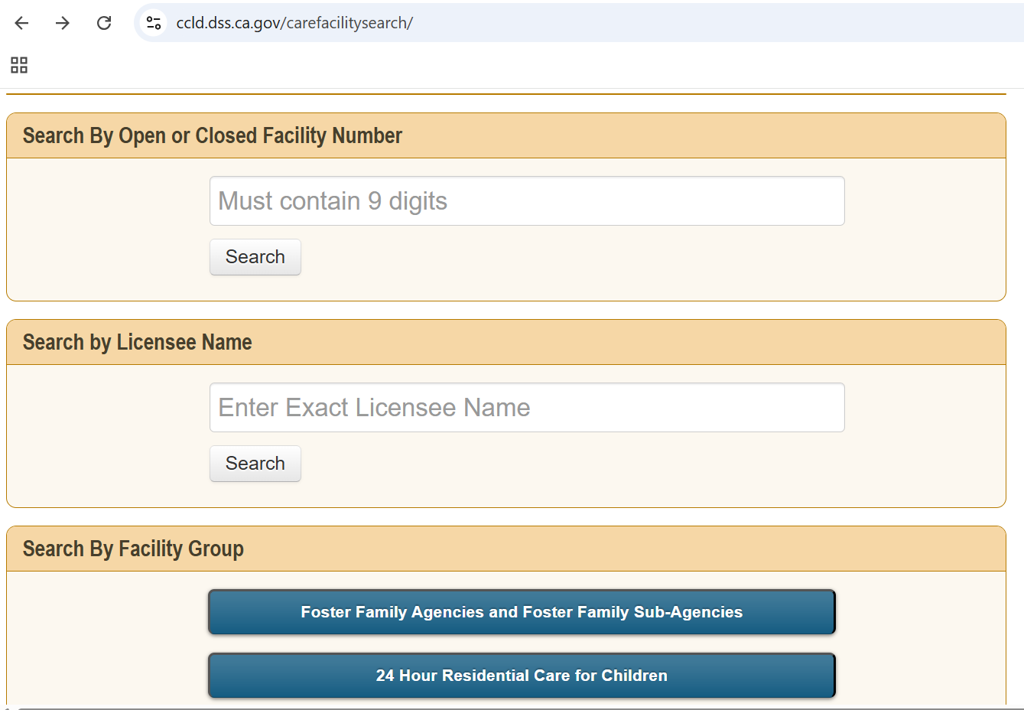
THPs and other licensed foster care placements are “24 Hour Residential Care for Children”

Slide 47
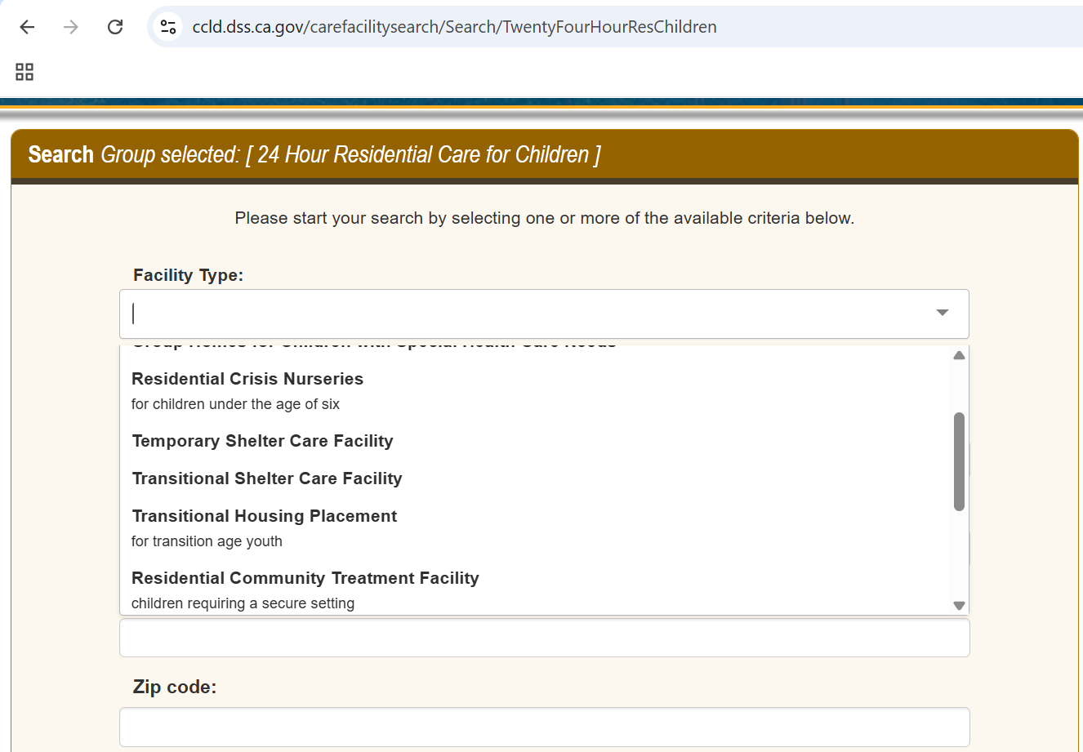
THP-NMD is licensed as a Transitional Housing Provider

Slide 48
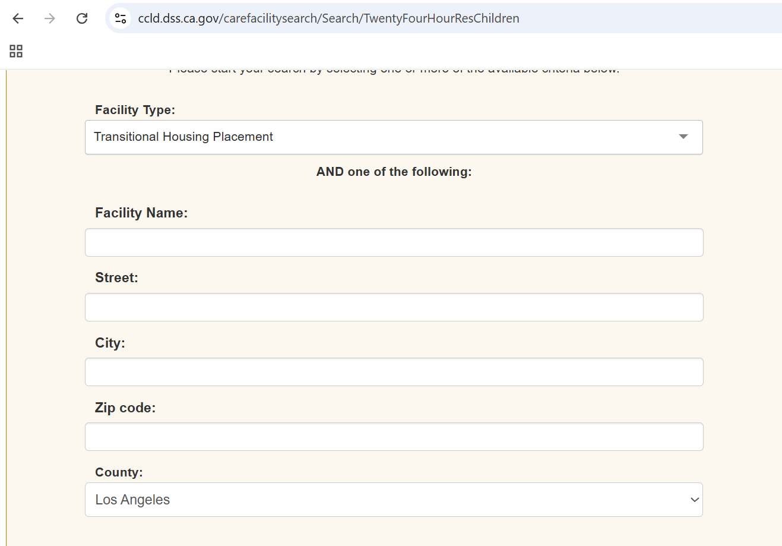
You can search by Facility Name, though the licensee may be different from the facility name
Generally, it is easiest to find a facility by searching by county where it is located

Slide 49
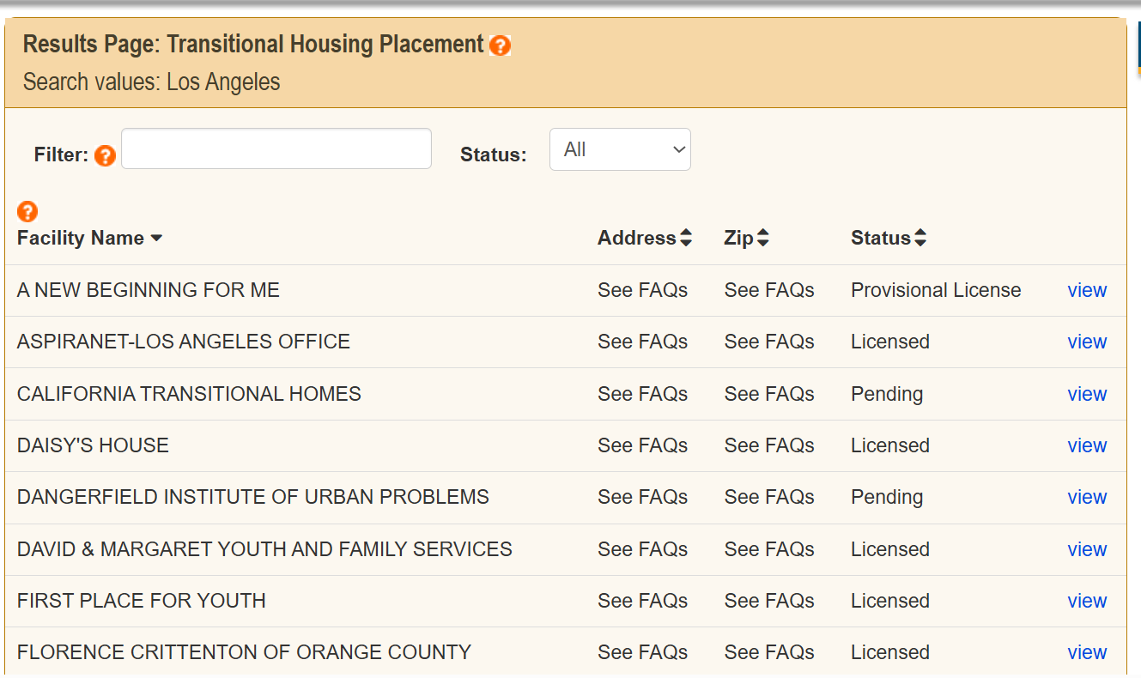
Click “view” to review each facility’s profile

Slide 50
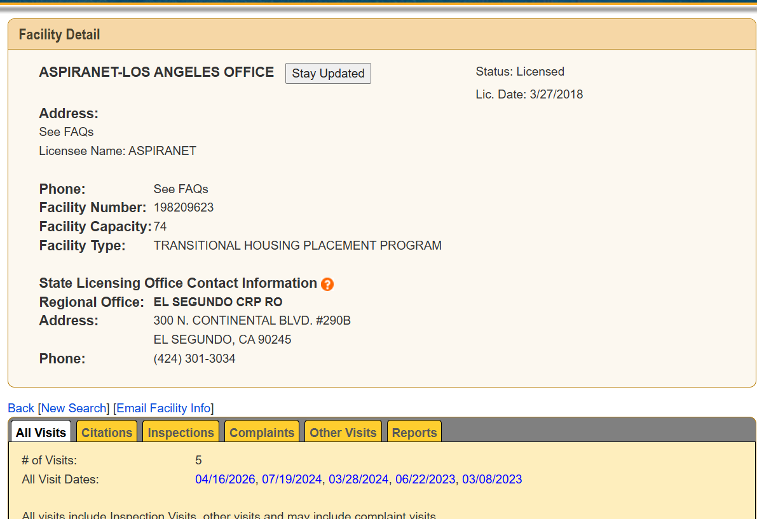
Note: these two names may be different because the licensed person or entity may be different than the name of the facility.
These are broken down further based on the type of visit.
Reviewable reports

Slide 51
Why are CCL Complaints Important?
Anecdotal information from youth advocates suggests that many violations of licensing standards are unreported. As a result, young people may remain or continue to be placed in unsafe facilities that are harmful to their well-being, and facilities have little incentive to change their practices.
Community Care Licensing (CCL) complaints can help to ensure that youth are treated with respect in safe and healthy environments, receive the developmental and social services to which they are entitled, are not improperly discharged, and are free from abuse and neglect.
On an individual level, filing a CCL complaint regarding a licensing violation can be an imperfect means of advocacy for situations where a violation(s) has occurred, but resolution of the issue could result in a young person maintaining their housing or placement.
Finally, each citation that is subsequently corrected represents improved safety or conditions for a young person that is placed at the facility. Filing complaints is an important way to help ensure that the licensing regulations are being followed and to document circumstances that could become patterns or systemic problems just to highlight how important making a record can be.

Slide 52
Resources
Youth Law Center Resources
  Policy Alert: Permanent Regulations for the Transitional Housing Placement Program for Nonminor Dependents (THP-NMD) are Now in Effect
  Fact Sheet: Transitional Housing Placement for Non-Minor Dependents (THP-NMD)
  Template Reasonable Accommodation Request
  THP-NMD: An Advocacy Guide to Preventing Involuntary Exits
  Maximizing Housing Entitlements for Current and Former Foster Youth
  Community Care Licensing (CCL) Complaints: An Overview for Advocates
CDSS Resources
  California Department of Social Services, Community Care Licensing Division Frequently Asked Questions (FAQs) for Communication with Complainants
  CCL Transparency Website
  CCL Online Complaints
  Foster Care Ombudsperson Complaints
  CCLD Evaluator Manual

Slide 53

What Would be Helpful to Your Practice?
Scan QR Code or visit: https://app.sli.do/event/iHihXwVmkR4vXNixBdfWJx
Examples may include: Know Your Rights Training for NMDs, "Crosswalk" of key changes to the regulations comparing them to the old Interim Licensing Standards, Judicial Bench Guide related to NMD placements, sample request for an assistance animal to reside in THP-NMD with the NMD, etc.

Slide 54
Questions?
  Marisa Lopez-Scott
  Directing Attorney
  Youth Law Center
  mlopez@ylc.org
  https://www.ylc.org/

Slide 55

Webinar resources, including recording and supplemental materials, will be posted at https://allianceforchildrensrights.org/resources/
THANK
YOU
@allianceforchildrensrights
STAY CONNECTED
allianceforchildrensrights.org
Notes:
Kristin/Sara
Thank you for joining us today and for your commitment to supporting transition age youth in accessing safe and stable housing. Special thanks to Marisa for sharing her expertise and best practice tips.
Please complete the survey you’ll receive after the webinar and join us on July 22 for our Credit Protection
for Youth in Foster Care: Understanding the Law, County Responsibilities, and Best Practices for Youth & Supporters presented by Jessica Heldman with the Children’s Advocacy Institute, University of San Diego law School.

