Slide 1
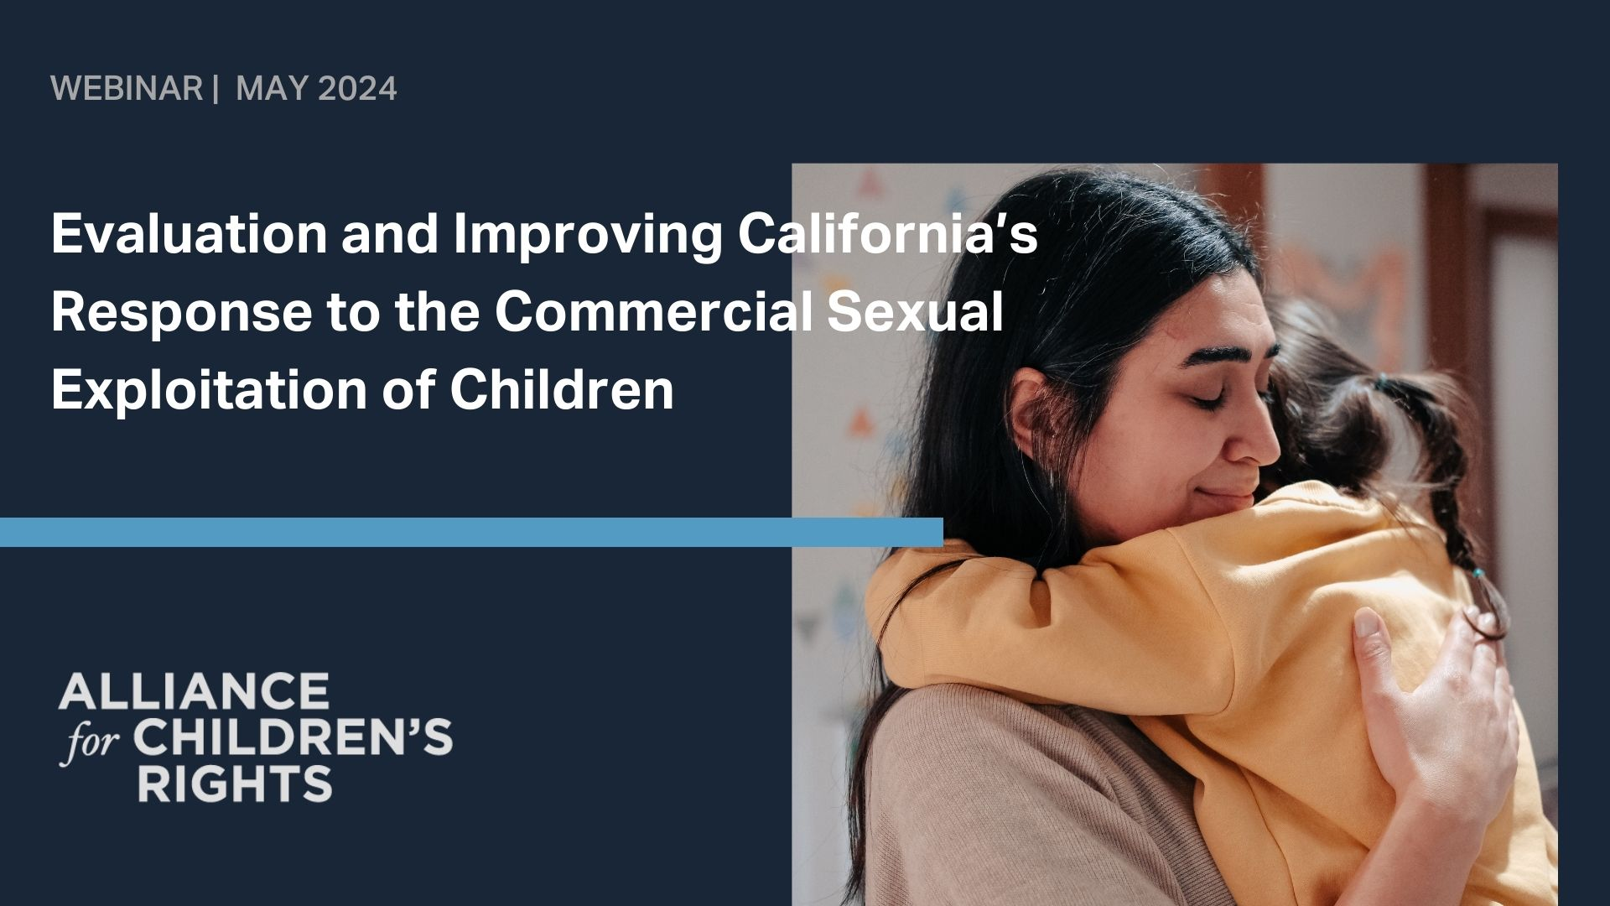
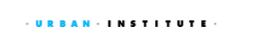
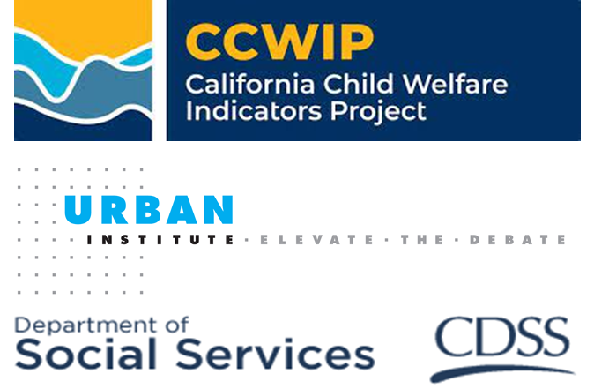
Evaluating and Improving California's Response to the Commercial Sexual Exploitation of Children
Kelley Hartman-Barr and Darrin Holt
CHILD TRAFFICKING RESPONSE TEAM
DEPARTMENT OF SOCIAL SERVICES
Ivy Hammond, PhD, MSW
CALIFORNIA CHILD WELFARE INDICATORS PROJECT
UNIVERSITY OF CALIFORNIA, BERKELEY
Notes:
Kristin

Slide 2
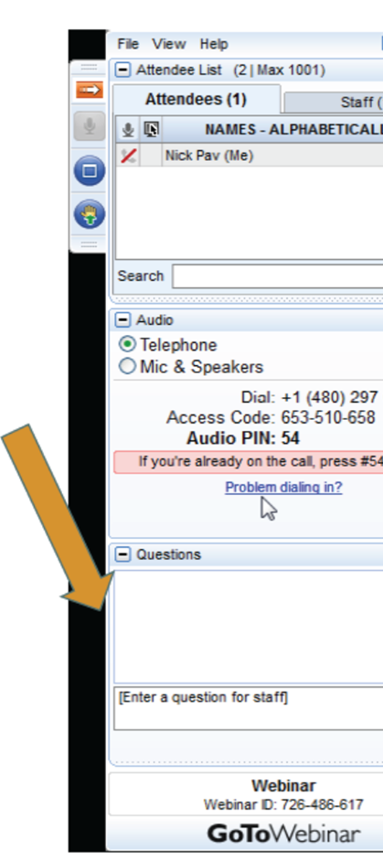
Logistics
Webinar resources, including recording and supplemental materials, will be posted at https://allianceforchildrensrights.org/resources/
All attendees are muted during webinar.
Please submit questions using the “Questions” function on your GotoWebinar dashboard.
Notes:
Kristin
Webinar resources, including the recording of today’s webinar, the presentation slides and supplemental materials, will be posted at https://allianceforchildrensrights.org/resources/
All attendees are muted during webinar.
Please submit questions using the “Questions” function on your GotoWebinar dashboard.

Slide 3
Presenters
Kelley Hartmann Barr
Manager, Child Trafficking Program Support Unit
Safety and Early Intervention Bureau
California Department of Social Services
Ivy Hammond
Associate Research Specialist
University of California, Berkeley
Darrin Holt
Manager, Child Trafficking Research and Policy Unit
Safety and Early Intervention Bureau
California Department of Social Services
Notes:
Kristin
I’m pleased to welcome Kelley Hartmann Barr, Ivy Hammond and Darrin Holt this morning. Our presenters will introduce themselves.

Slide 4
Do you work directly with families impacted by CSEC?
How familiar are you with CSEC procedures & resources?
Tell us about you . . .
Notes:
Kristin
Poll questions

Slide 5
California’s Response
What is SB 855?
In 2014, California enacted Senate Bill (SB) 855 which made 3 major changes:
  Defined which children are categorized as exploited.
  Clarified the child welfare system’s responsibility to intervene when a parent is unable to protect their child.
  Created the Opt-in CSEC Program, which gives participating county child welfare agencies guidance and funding to prevent and intervene on behalf of children who are exploited or are at-risk
Notes:
2 min
Federal changes over the last decade prompted states to develop policy aimed at CSE of children and youth, with a focus on those under the jurisdiction of the Child Welfare System.
The California legislature enacted SB 855 in 2014, which did 3 things.
First, it defined a commercially sexually exploited child as any child who is sexually trafficked or who receives food or shelter in exchange for, or who is paid to perform, sexual acts and whose parent or guardian failed or was unable to protect the child from commercial sexual exploitation.
Second, it clarified the cw system’s ability to intervene when a parent is unable to protect their child.
Third, it created the Opt-in CSEC Program, which gives county child welfare agencies guidance and funding to prevent and intervene on behalf of children who are commercially sexually exploited or are at-risk.

Slide 6
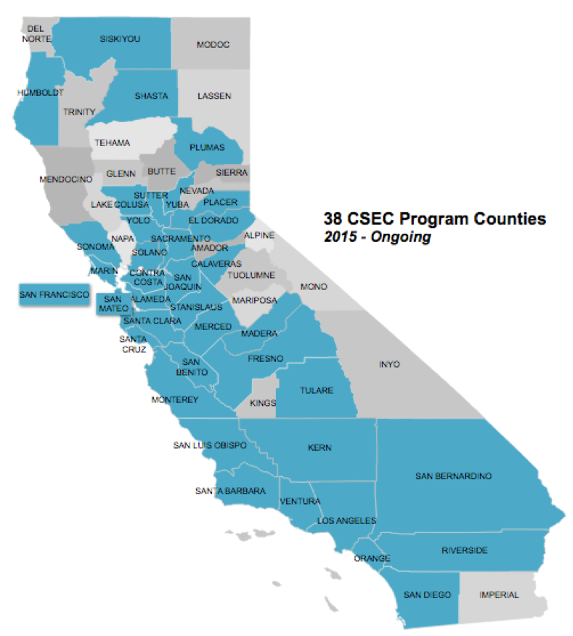
Senate Bill 855
To be eligible for such funding, counties had to implement the following CSEC program components required by SB 855:
An interagency protocol developed by, at a minimum, representatives from child welfare, probation, mental health, public health, juvenile courts, Sheriff’s Department and the Office of Education
Use of a multidisciplinary team (MDT) approach to case planning with participation from, at a minimum, representatives from child welfare, probation, mental health, public health, and substance abuse
38 counties opted in by 2015
47 opted in by 2020
Notes:
Since its inception, over 75 percent of counties in California have opted in (44 of 58), getting funding to develop interagency protocols and specialized services in order to identify, address, and prevent CSE. California is now well-positioned to evaluate SB 855, particularly its implementation across the state, but also the extent to which the legislation may be influencing desired outcomes for young people.
The CDSS contracted with the UC Berkeley and Urban Institute to conduct the evaluation.

Slide 7

ABOUT THE CALIFORNIA CHILD WELFARE INDICATORS PROJECT (CCWIP)
CCWIP is a collaborative venture between UC Berkeley and CDSS. It provides agency staff, policymakers, researchers, and the public with technical assistance and access to critical outcome information on California’s child welfare system.
ABOUT THE URBAN INSTITUTE
The Urban Institute is a nonprofit research organization that provides data and evidence to help advance upward mobility and equity. Urban is a trusted source for changemakers who seek to strengthen decision-making, create inclusive economic growth, and improve the well-being of families and communities.
This work was made possible by the California Department of Social Services’ Child Trafficking Program Support Unit
Notes:
CDSS Enlisted CCWIP and the Urban Institute to evaluate county-level implemtation of SB 855

Slide 8
Implementation Study
What are the components of SB 855 in terms of services, staffing, and organizational structure?
Are counties implementing SB 855 as expected? How did implementation vary?
Do counties have the capacity to meet the needs of CSEC?
What were the barriers and facilitators to implementing SB 855?
To what extent did agencies within counties implement collaboratively?
What are the key successes of SB 855? Challenges?
What are promising practices for implementing local CSEC response programs?

Slide 9
Implementation Study
Annual county plans
  A review of 200 county plans helped evaluators understand how counties collaborated and implemented SB 855 over time, variance from county to county, and barriers and facilitators to implementation
  Staff survey
    An online survey of CSEC Program coordinators was developed to capture the process/quality/capacity changes and cross-system collaboration that took place during SB 855 implementation across all participating counties.
    Case studies of 12 counties
      Key staff involved in implementation were interviewed and focus groups were held with adults with lived experiences of CSE as minors
Notes:
To study implementation, evaluators relied on three cascading primary data sources
Interviews were held with key staff involved in implementation.
Child welfare agency staff (62)
Lay Enforcement/Juvenile Probation staff (12)
Providers (29)
Other partner agency staff (29)
Focus groups with individuals who could speak more directly about CSEC experience (e.g., adults with lived experience).
12 participants
Survey response rate: 98% - 46 out of 47 counties
12 site visit counties selected based on:
Geography:
Region
Urbanicity
Population:
Rates of CSE referrals
Implementation Score:
Size + Implementation score
CSEC funding levels
Pilot County

Slide 10
System Outcome - Research Questions
Based on administrative data in California’s Child Welfare Services Case Management System (CWS/CMS), to what extent is commercial sexual exploitation being documented and assessed by the CPS?
Among young people who met the state’s definition of having experienced CSE victimization or CSE risk…
What can we learn about their child welfare system involvement?
How timely were counties’ responses following CSE identification?
Did system responses differ by SB 855 implementation?

Slide 11
Scope
Findings from the system outcome study documented the approximate scope of CSE maltreatment known to the child protection system:
Between 2015 and 2021, a total of 70,334 reports were made in opted-in counties alleging concerns of CSE.
Between July 2015, and December 2021, 38,168 minors had concerns of commercial sexual exploitation documented by child welfare agencies.
    Roughly 1 in 4 youth had confirmed CSE victimization documented
    About 14% were in child welfare cases when concerns of CSE were first documented and an additional 15% had a case opening within 12 months
    About 12% were in foster care and an additional 10% entered foster care within 12 months of the initial CSE concern
Notes:
The evaluation highlights key findings from both the implementation study and the outcome study in the executive summary and the body of the evaluation.
About two-thirds (63.5%) of CSE reports were screened in for investigation.
Nearly one in six (15.5%) CSE reports was substantiated.
Case openings and placement entries were more common among youth with confirmed CSE victimization . Among those with confirmed experiences of CSE…
CASE About 17% were in child welfare cases at the time concerns of CSE were first documented
CASE An additional 45% had a child welfare case opening within 12 months of CSE
PLACEMENT About 15% were in care at the time concerns of CSE were first documented
PLACEMENT An additional 34% entered foster care within 12 months

Slide 12
Key Findings
Screening and data collection varied statewide, limiting how we can use and interpret available data
Average age of children at time of initial CSE concerns (confirmed and unconfirmed) was 12 years
At the time caseworkers or mandated reporters documented initial CSE concerns, few youth were in a child welfare case (in-home or out-of-home)
Majority of youth impacted by CSE had low placement instability; however, available data does not reflect absences from placement that fall short of a placement change
Notes:
We identified an absence of administrative records on specialized service receipt, brief absences from care, and revictimization. This exposes a potential need for data tools to document child-level service and placement events that may be necessary to track incremental improvements following CSE.
We need more nuanced data to fully understand placement disruptions youth impacted by CSE.
We observed that uneven knowledge about inputting and accessing CSEC data is a barrier to collaboration. When staff do not know how to access or update case information in CWS/CMS, partner agencies cannot stay abreast of case decisions or a youth’s service use. Staff turnover across county agencies, staff confusion on best practices for managing and entering data, and problems sharing case information across agencies were identified as challenges.

Slide 13
Key Findings
Need for more specific trainings and an emphasis on training for parents, relative caregivers, and foster parents
Significant amount of youth impacted by CSE are placed with relative caregivers
Lack of available services, specifically lack of CSEC-informed behavioral health services
Counties are limited in their ability to serve youth impacted by CSE without an open child welfare case

Slide 14
Best / Promising Practices
Assigning CSE cases to specific frontline workers rather than distributing them throughout the workforce
Weighting CSE cases more heavily when calculating caseloads against burnout by acknowledging that such cases are more work intensive
Dual response from child welfare and CSE advocates; On-staff clinicians with a specialization in working with youth who have experienced CSE, and staff dedicated to recovering missing youth
Partnering with outside organizations is effective in engaging vulnerable youth who are not currently Child Welfare involved
Notes:
The evaluation also provides best / promising practices that were learned from counties through the implementation and outcome studies. Some of these best / promising are:

Slide 15
Best / Promising Practices
Development and implementation of the Protocol for Working with Indian Families, Children and Tribes in partnership with local Tribes
Ensuring representative from the local Tribe is invited to all Multi-Disciplinary Team meetings that involve an AI/AN youth
A county is part of the Bay Area Collaborative of American Indian Resources, a partnership with the AI/AN community, service providers, and local elders
Notes:
Best / promising practices in engaging and involving Tribes in the implementation of County CSEC Programs were identified by several counties and are included in the evaluation and appendix. Some of those best / promising practices are:

Slide 16
Policy and Practice Recommendations
Improve identification practices to promote equity, reduce bias, and decrease time before identification
Improve access to and use of lived experience expertise and voice for county child welfare agencies and their partners to inform their programs
Improve access to targeted secondary trauma support for county CSEC Program staff
Enhance training and technical assistance to support the implementation of harm reduction for county child welfare agencies and their multidisciplinary partners, including community organizations
Enhance prevention and differential response capacities and strategies

Slide 17
Policy and Practice Recommendations
Explore innovative approaches to placement
Build CSE expertise among behavioral health partners through increased state and local level partnerships
Continue to work with Child Welfare Digital Services (CWDS) to develop measures to track data and demonstrate outcomes in the Child Welfare Services – California Automated Response and Engagement System (CWS-CARES) that better align with the trajectories of youth impacted by CSE
Continue encouraging County partners to engage local Tribes to ensure a Tribal perspective is included in not only their CSEC program implementation, but also their ongoing work and understanding of the impacts of CSE on the AI/AN community

Slide 18
Policy & Practice Recommendations
Continue to explore ways to promote service continuity to ensure youth impacted by CSE can maintain relationships with trusted individuals
Continue to support counties in developing best practices in developing and implementing policies and procedures to locate and serve youth missing from care
Promote prevention practices to prevent youth who are vulnerable to CSE from becoming victims
Ensure Juvenile Justice involved youth have access to the same services and supports as dependents

Slide 19
Next Steps
Listening Session #1:
Informed by findings from the SB 855 evaluation, the Department of Social Services’ Child Trafficking Response Team is soliciting input directly from the child welfare workforce to identify specific strategies for strengthening efforts to prevent and address CSEC.
Specifically, the CTRT is gathering recommendations related to the following:
  Screening procedures (e.g., tools; timing, training; tracking)
  CSE Tracking (e.g., initial vs re-occurrence of CSE victimization; risk; service need/interest)
  CSE psychoeducation and support for parents, legal guardians, and kinship caregivers

Slide 20
Next Steps
Listening Session #2:
Informed by findings from the SB 855 evaluation, the Department of Social Services’ Child Trafficking Response Team is soliciting input from service providers and program administrators embedded within CSEC programming to identify specific strategies for strengthening efforts to prevent and address CSEC.
Specifically, the CTRT is gathering recommendations related to the following:
  Serving young people with CSE concerns that do not enter the child welfare system (non-dependent youth)
  Successful Multidisciplinary teaming (e.g., format; structure; communication; participants)
  Cross-county, interstate, and dual-system protocols and procedures

Slide 21
Acknowledgements
  The CDSS would like to thank:
    The staff of UC Berkeley CCWIP and their partners at the Urban Institute.
    Our colleagues in the CDSS – Research, Automation and Data Division.
    The Child Welfare Council’s CSEC Action Team.
    Preventing and Addressing Child Trafficking (PACT) Program – of the Child and Family Policy Institute of California.
    The lived experience experts that informed the study through participation in focus groups.
    Special Thanks to: Alia Azariah, Cari Herthel and Tkeyah Dupclay as well as the CSEC Action Team’s Advisory Board.

Slide 22
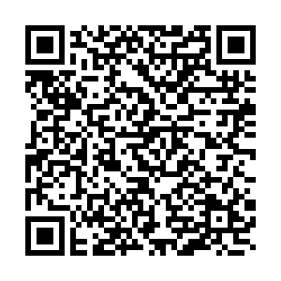
Thank you for your time
For our full report, scan:
Contact: Ivy_Hammond@berkeley.edu

Slide 23
Additional Information
ACIN I-06-24 - Evaluating California’s Efforts To Address The Commercial Sexual Exploitation Of Children: An Evaluation Of The Commercially Sexually Exploited Children Program Established Through Senate Bill 855
Email – CSECProgram@dss.ca.gov

Slide 24
Tell Us More
How does this information resonate with your experiences?
What barriers have you encountered in supporting families impacted by CSEC?
What more do you need to best support families impacted by CSEC?
Notes:
Kristin
How does this information resonate with your experiences?
What barriers have you encountered in supporting families impacted by CSEC?
What more do you need to best support families impacted by CSEC?

Slide 25

Webinar resources, including recording and supplemental materials, will be posted at https://allianceforchildrensrights.org/resources/
@allianceforchildrensrights
THANK
YOU
STAY CONNECTED
allianceforchildrensrights.org
Notes:
Kristin

